Slide 1

Advance Volume

Slide 2
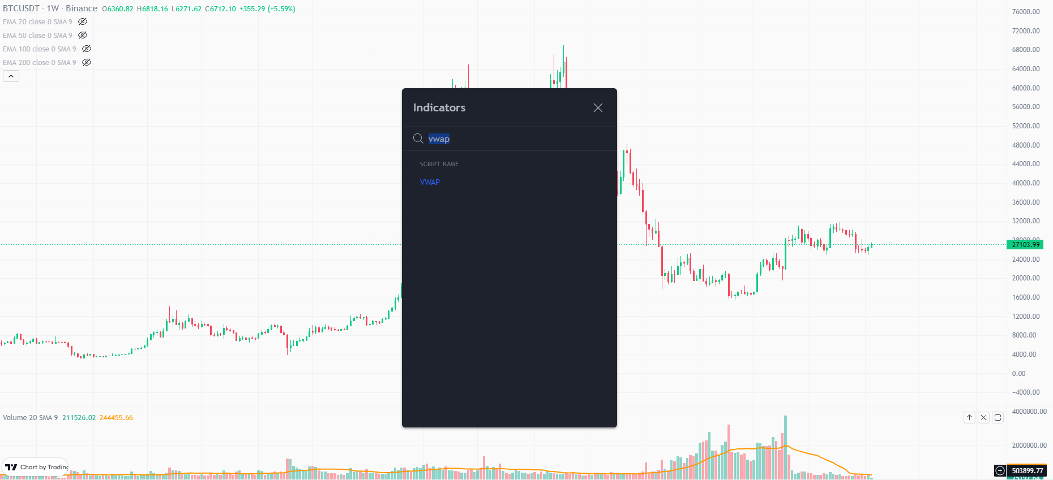
VWAP

Slide 3
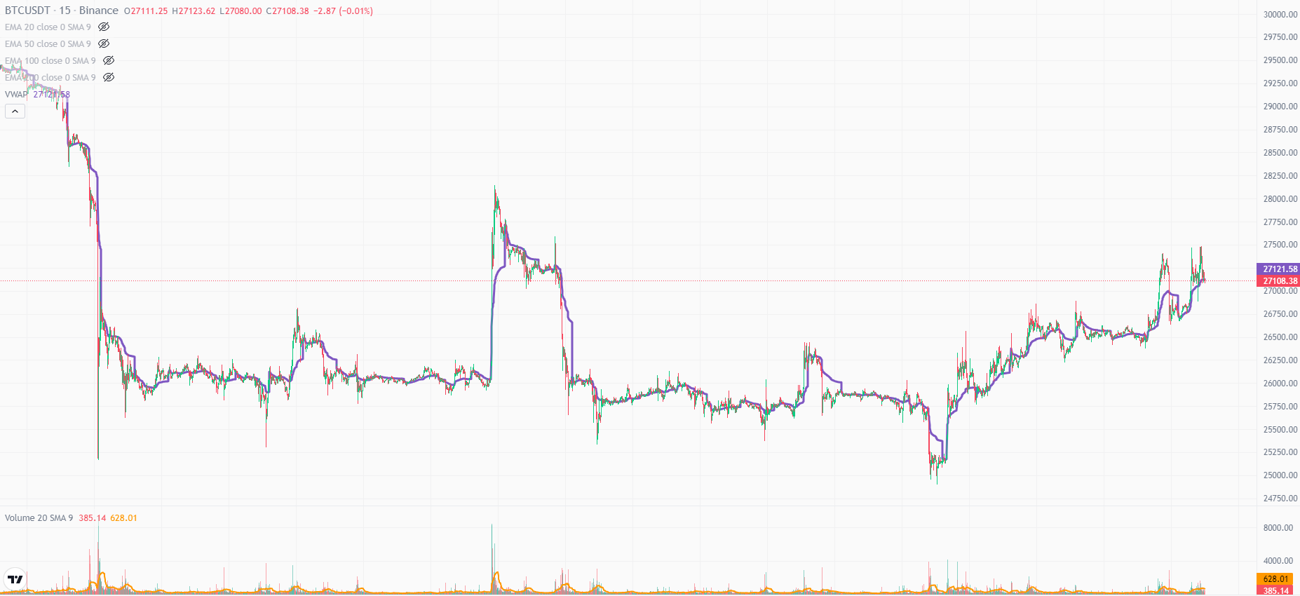
VWAP

Slide 4
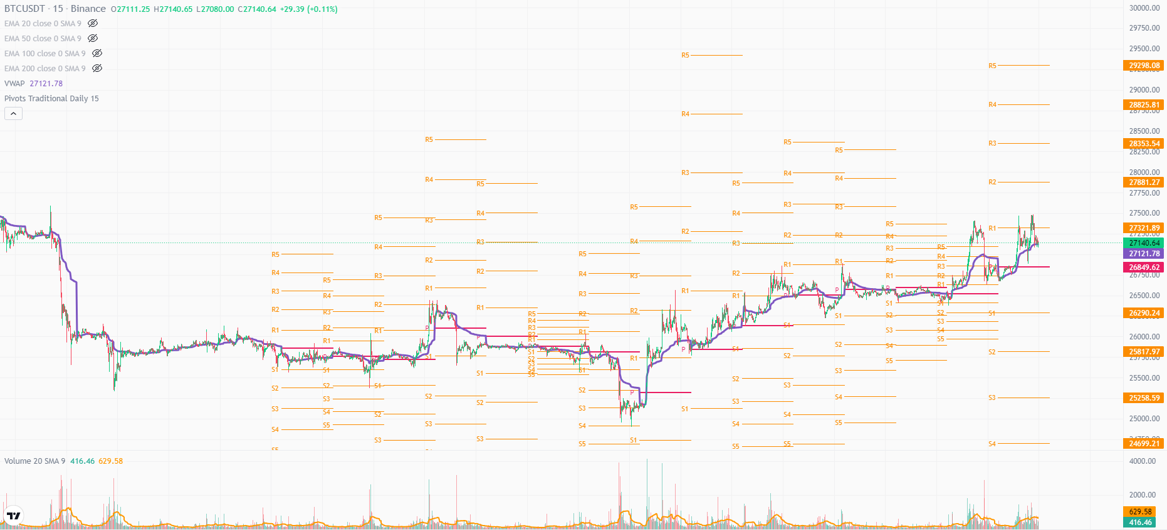
VWAP + Pivot Points

Slide 5
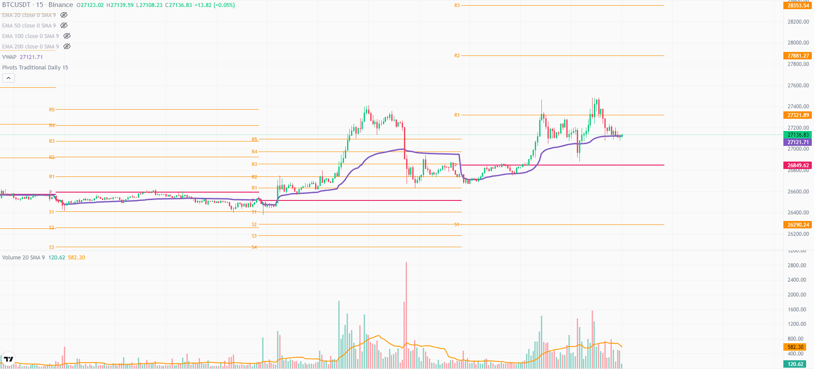
VWAP + Pivot Points - Scenario 1
Notes:
VWAP moves in all three trends.
Acts as support/resistance.
If price is going above vwap then it will be bullish.
if it’s below vwap then its bearish.
Whales may take support of VWAP to bounce upward.
Scenario 1 - Usual rally pattern is, at the start of the day, VWAP dumps (self adjustment), price takes support of VWAP, crosses pivot and rally up.

Slide 6
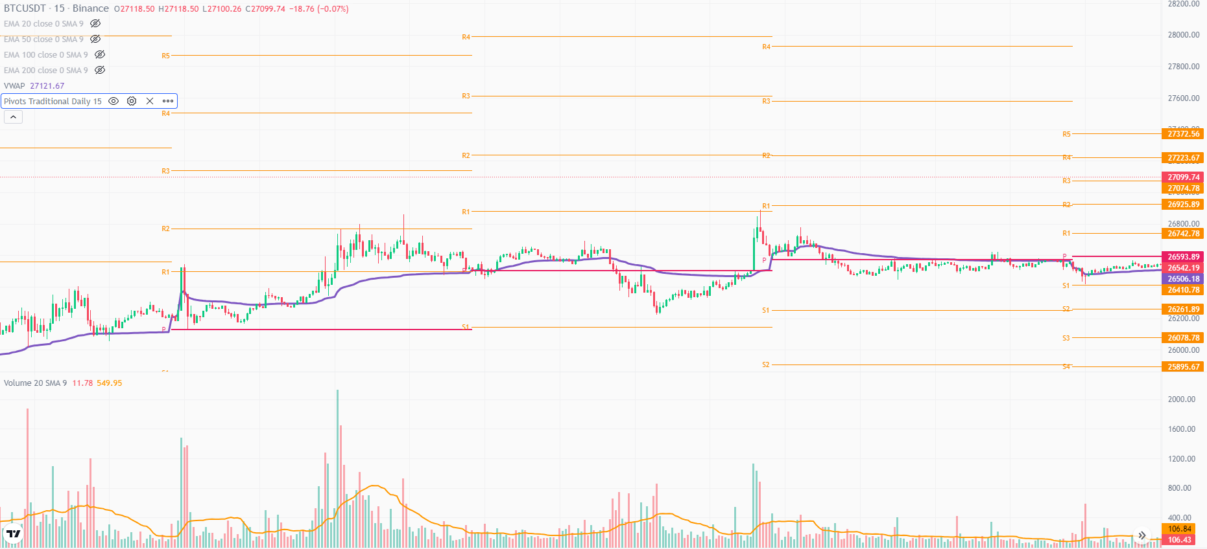
VWAP + Pivot Points - Scenario 2
Notes:
Scenario 2 - VWAP pumps upwards (self adjustment), then acts as resistance for price the whole day.

Slide 7
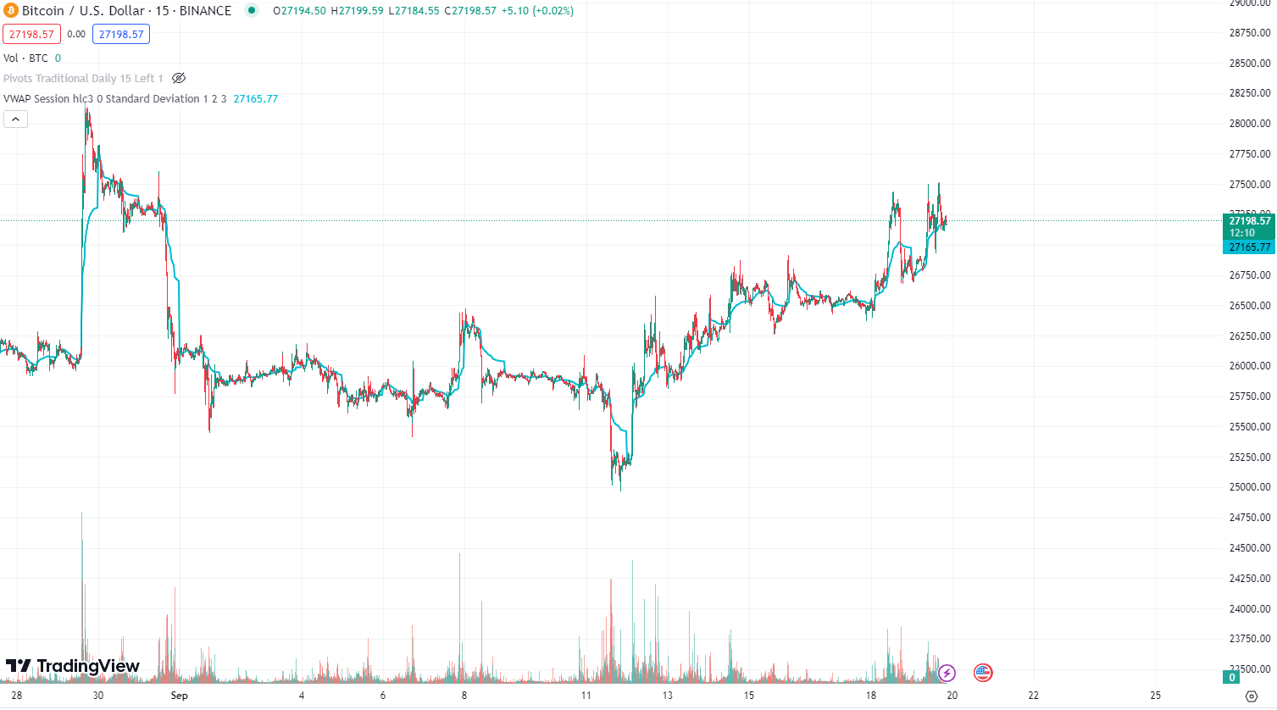
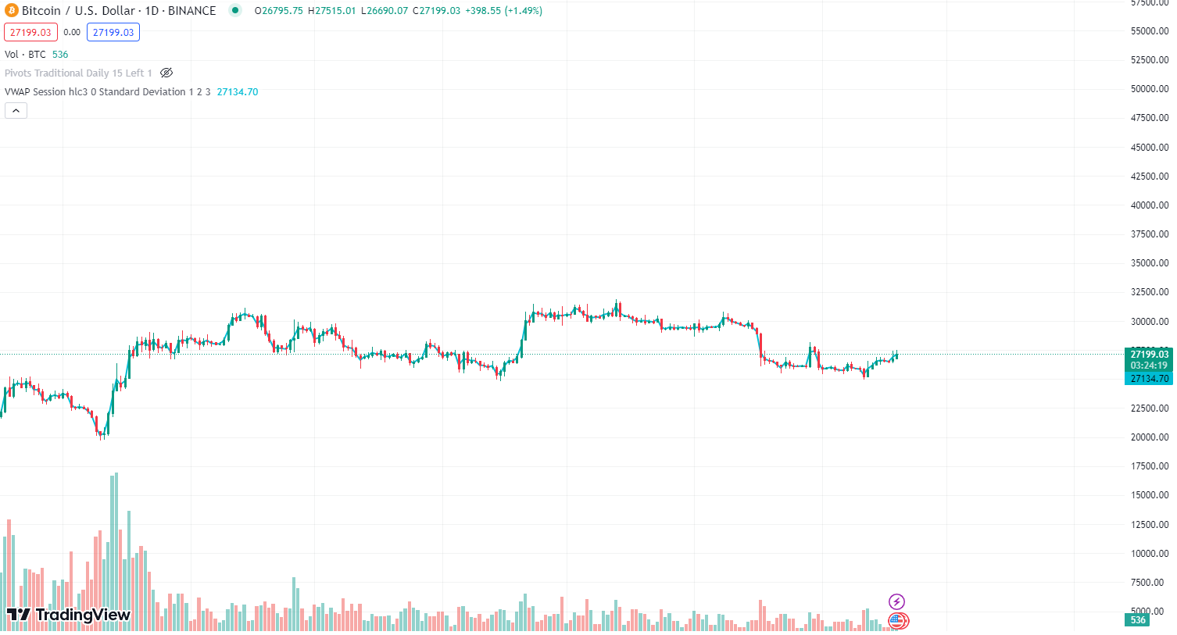
Problem?
Notes:
VWAP doesn’t work properly for bigger time frames.

Slide 8
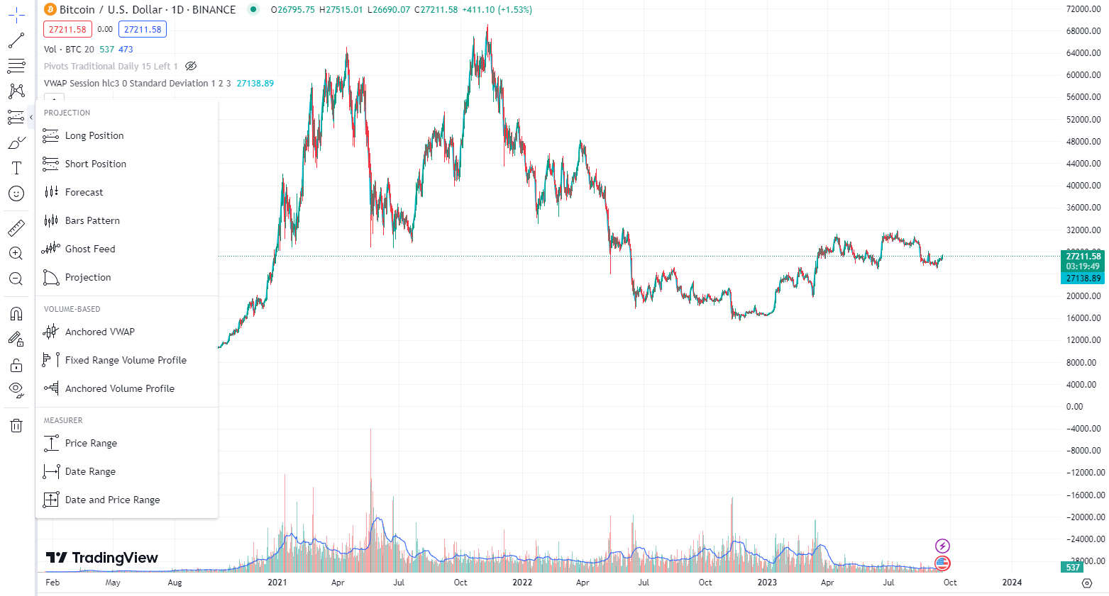
Anchored VWAP
Notes:
VWAP is an intraday tool. So at bigger timeframes, 4h, 1D, 1W it doesn’t work that well.

Slide 9
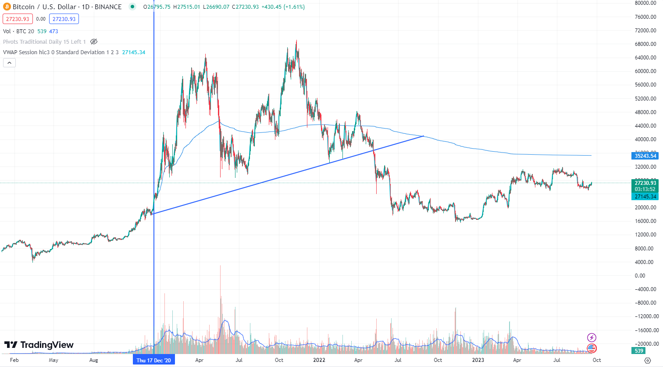
Anchored VWAP

Slide 10
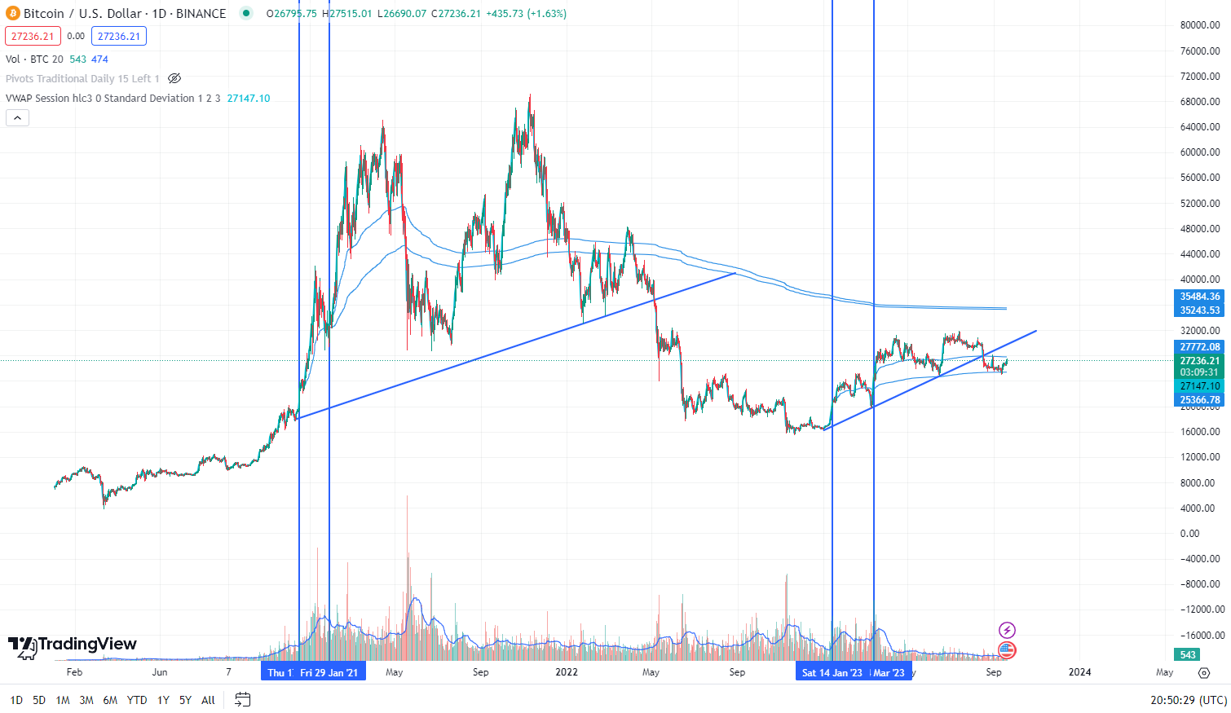
Anchored VWAP

Slide 11
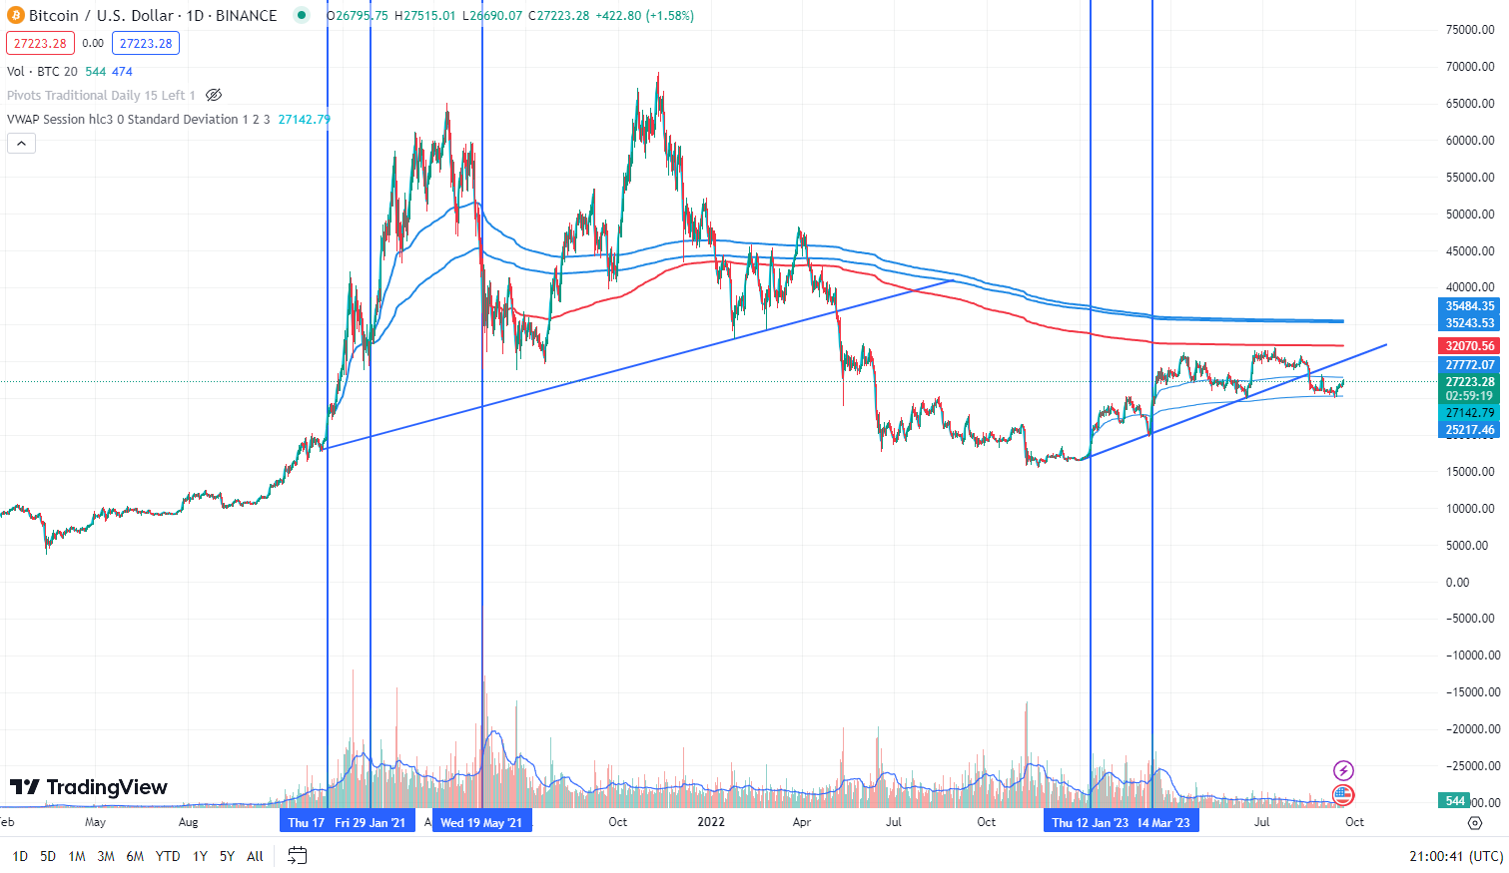
Anchored VWAP

Slide 12
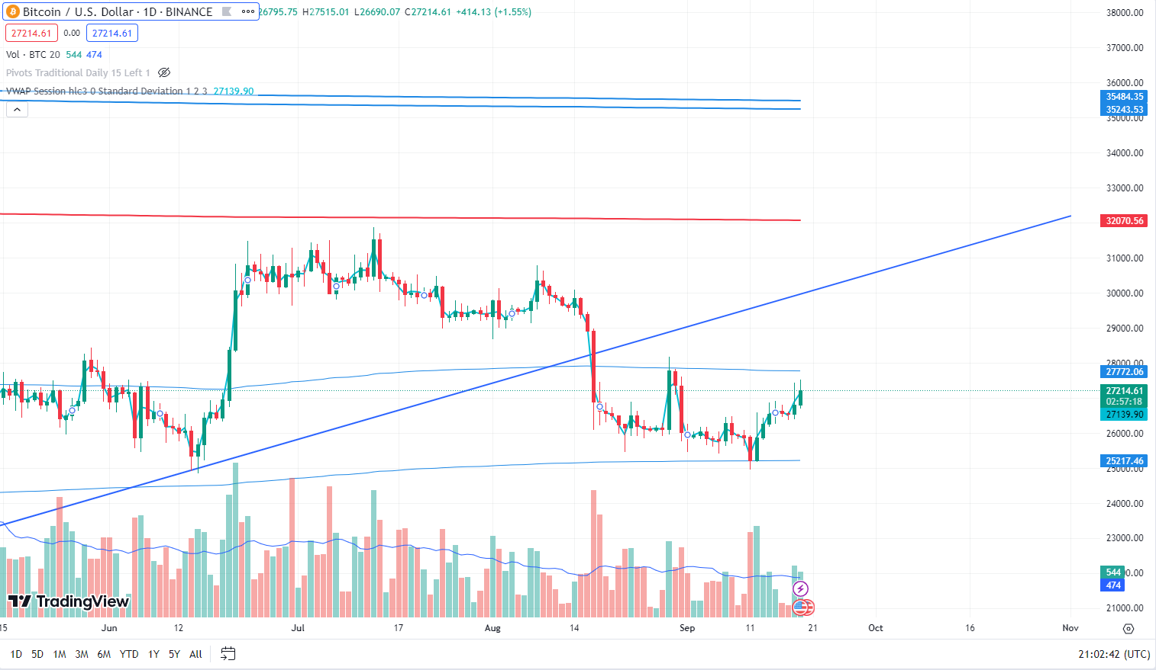
Anchored VWAP

Slide 13
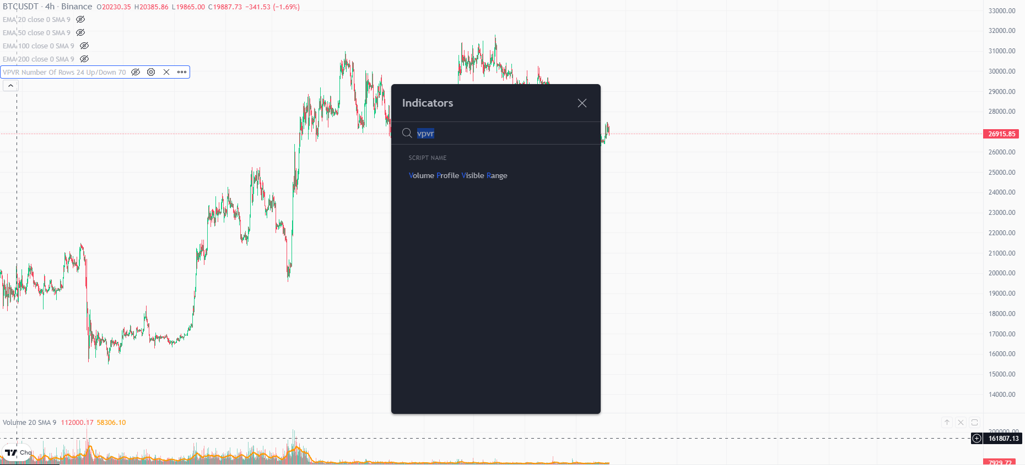
VPVR

Slide 14
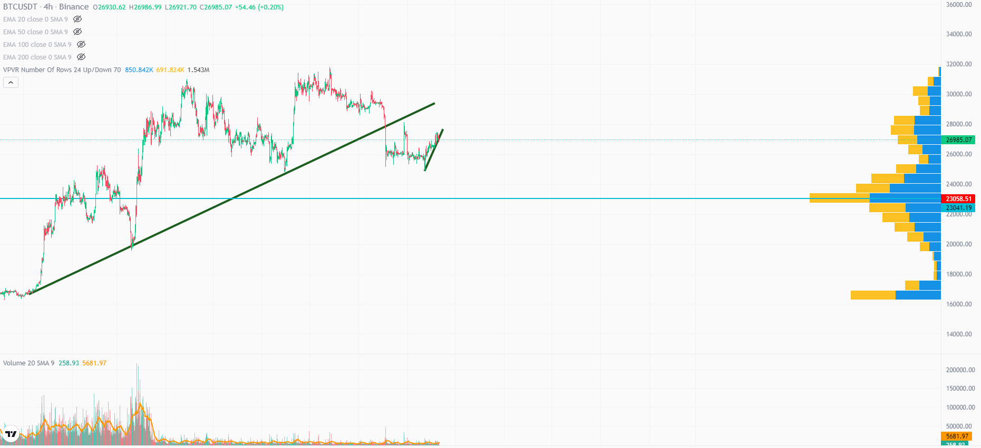
VPVR

Slide 15
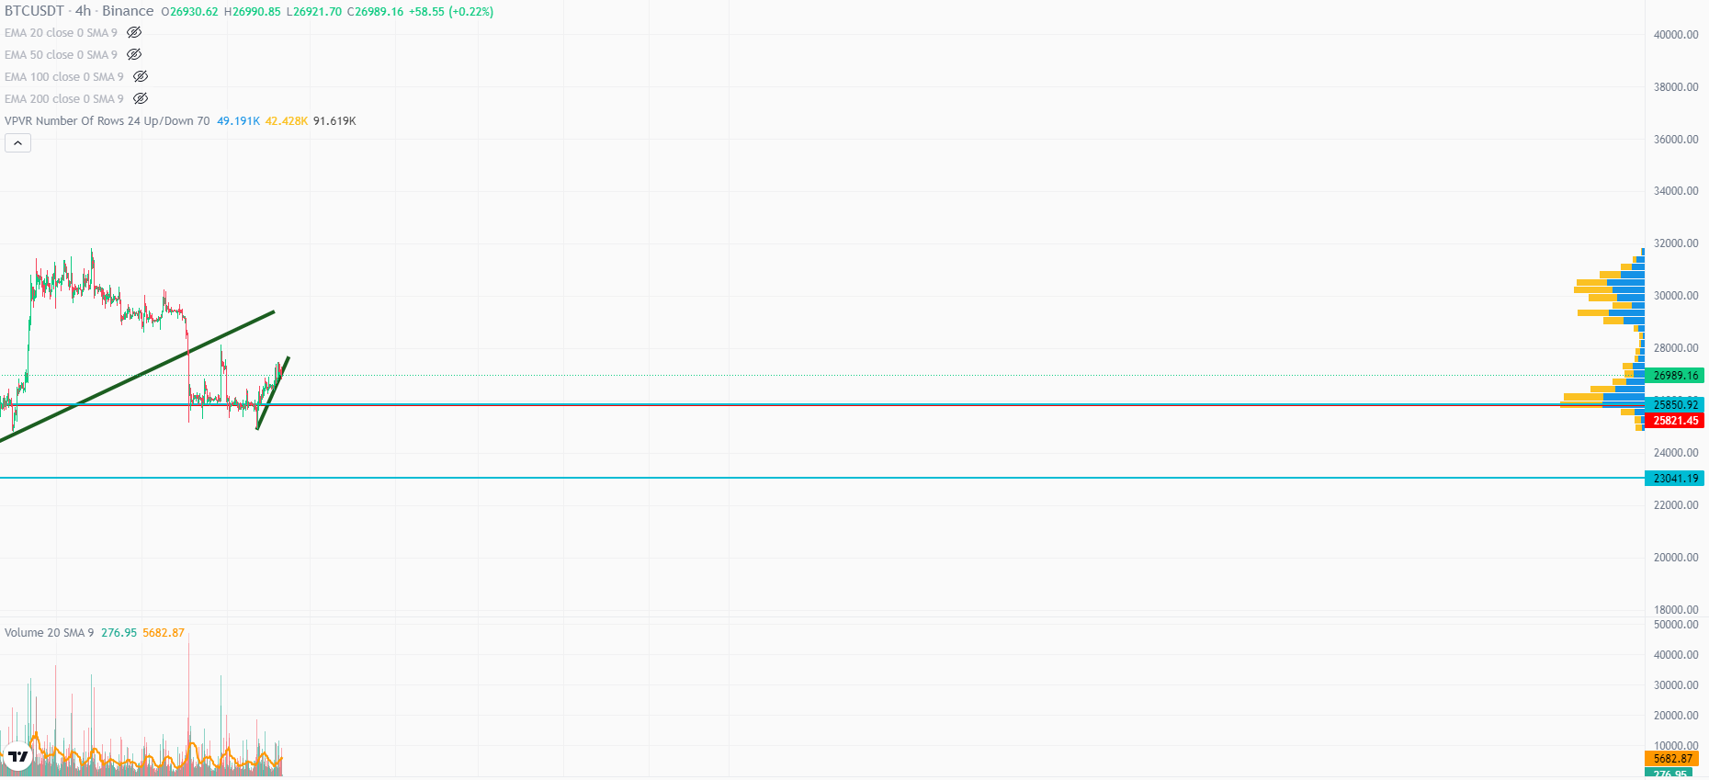
VPVR

Slide 16
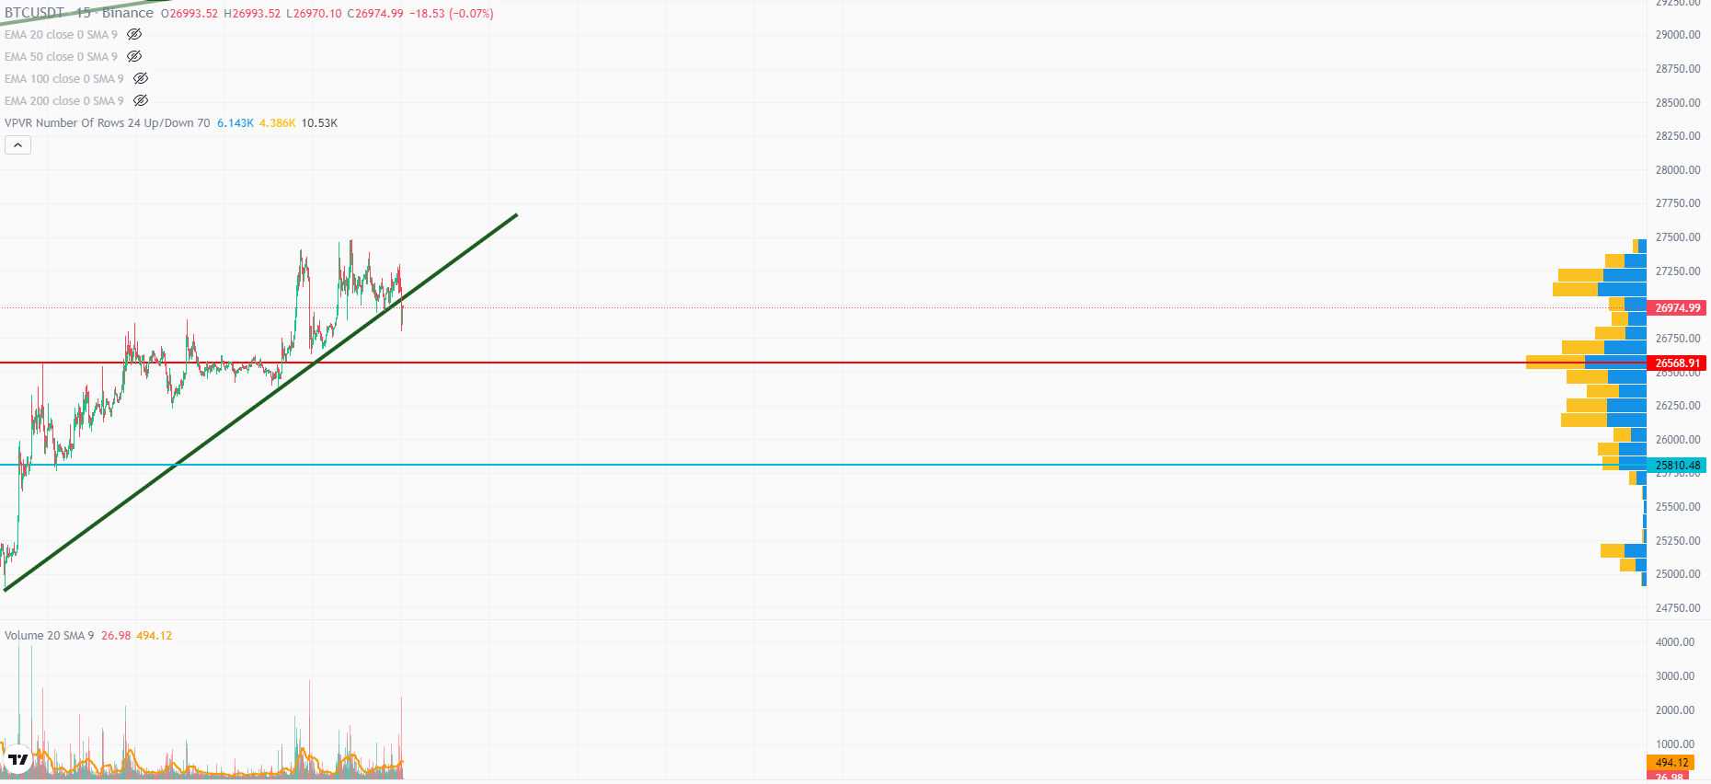
VPVR

Slide 17
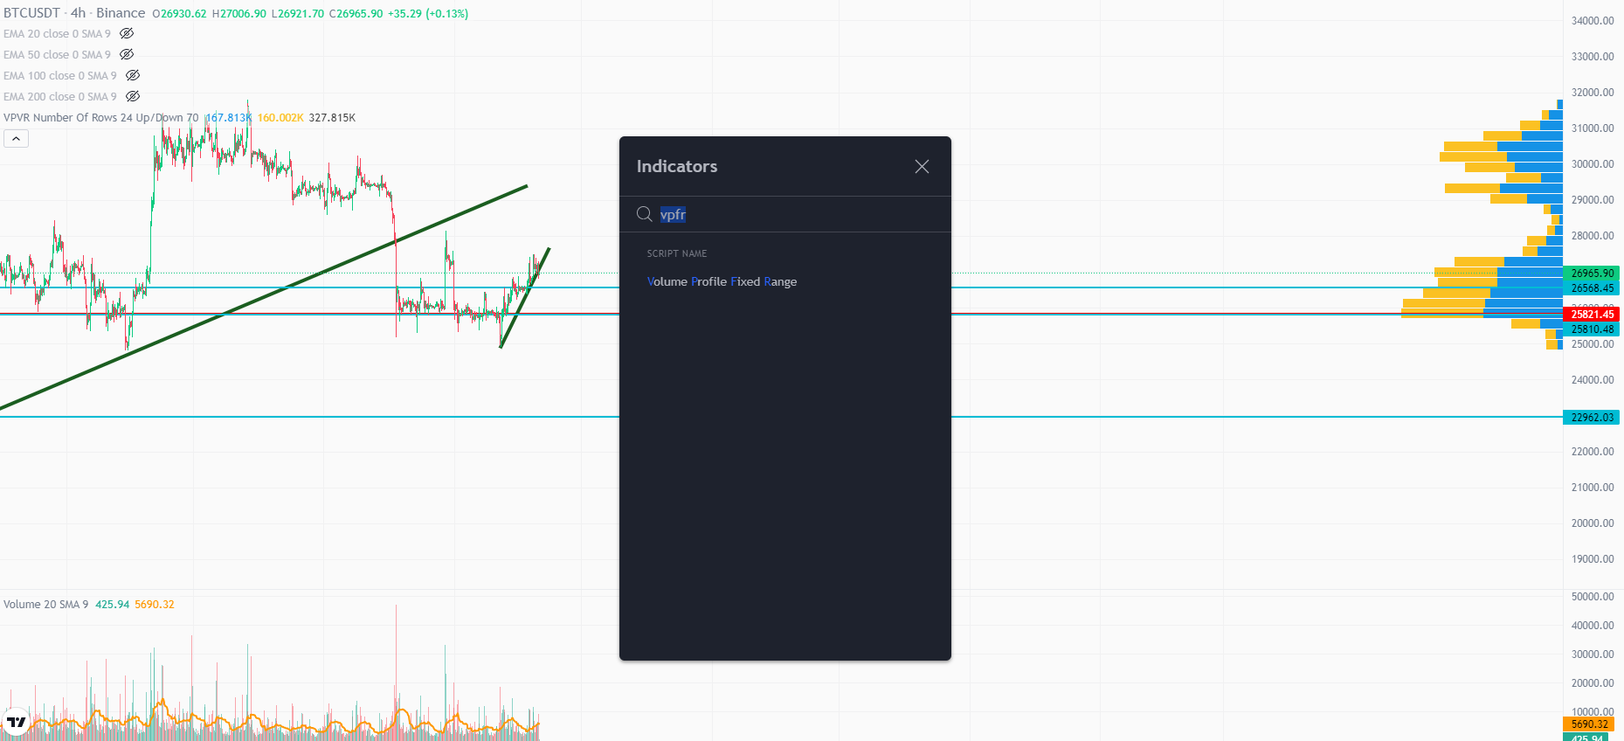
VPFR

Slide 18
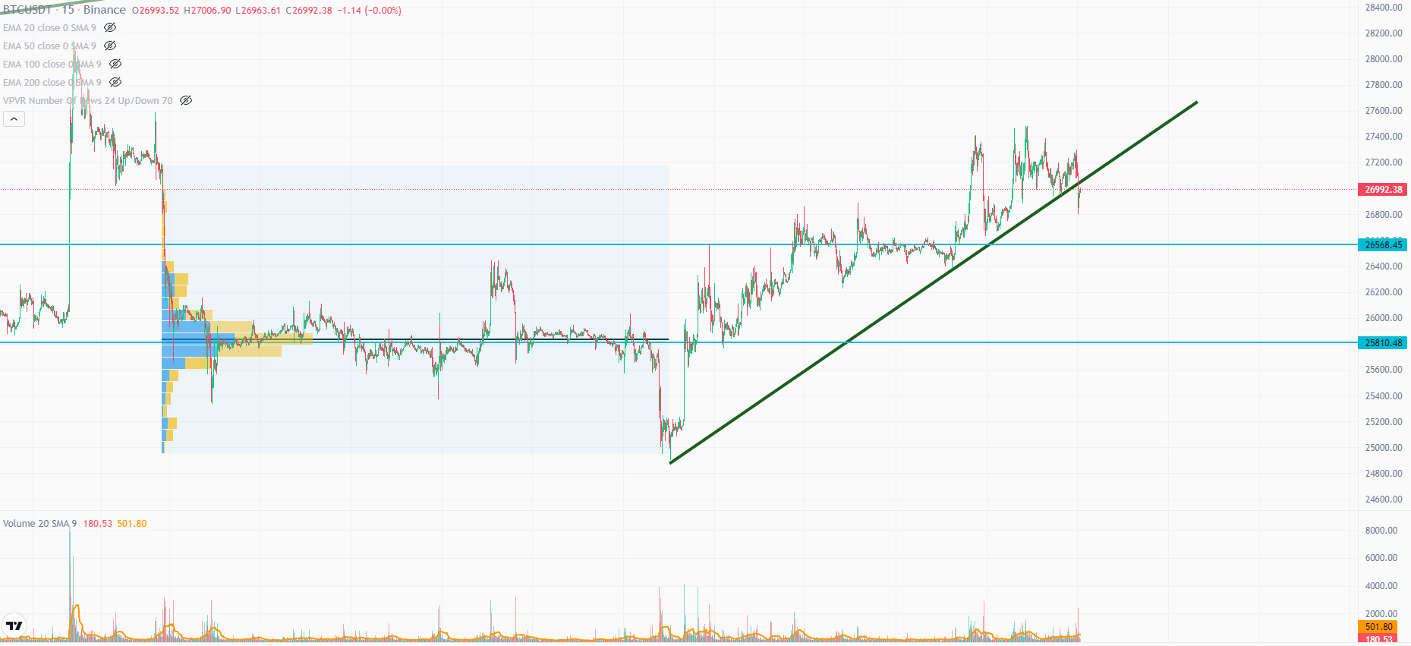
VPFR

Slide 19
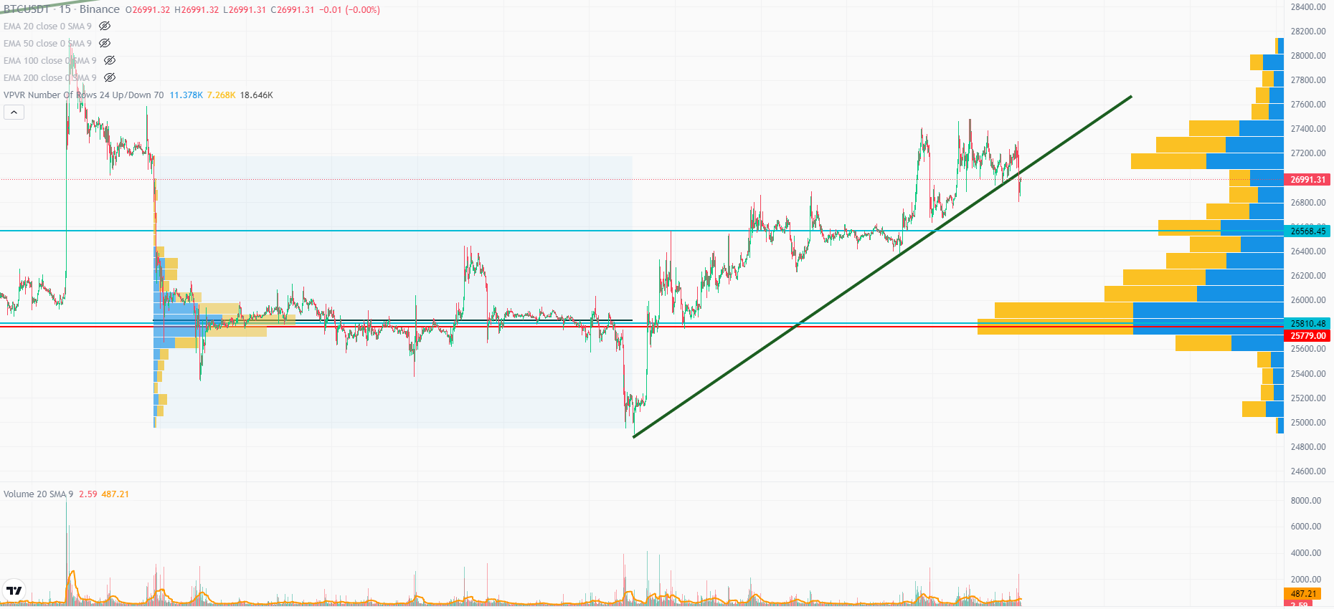
VPFR

Slide 20
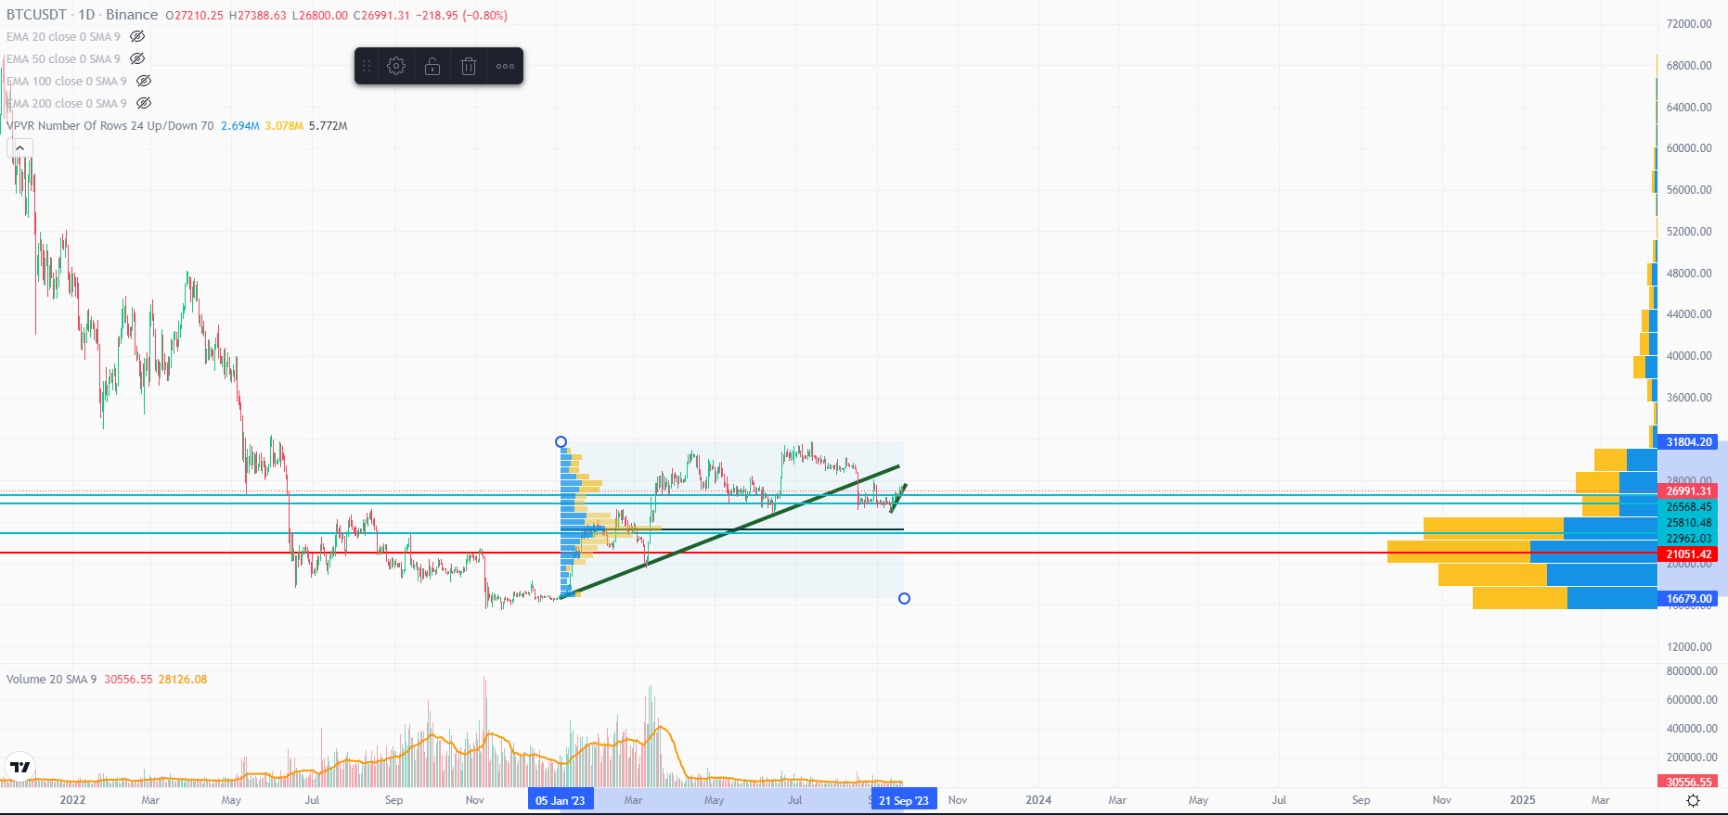
VPFR

Slide 21
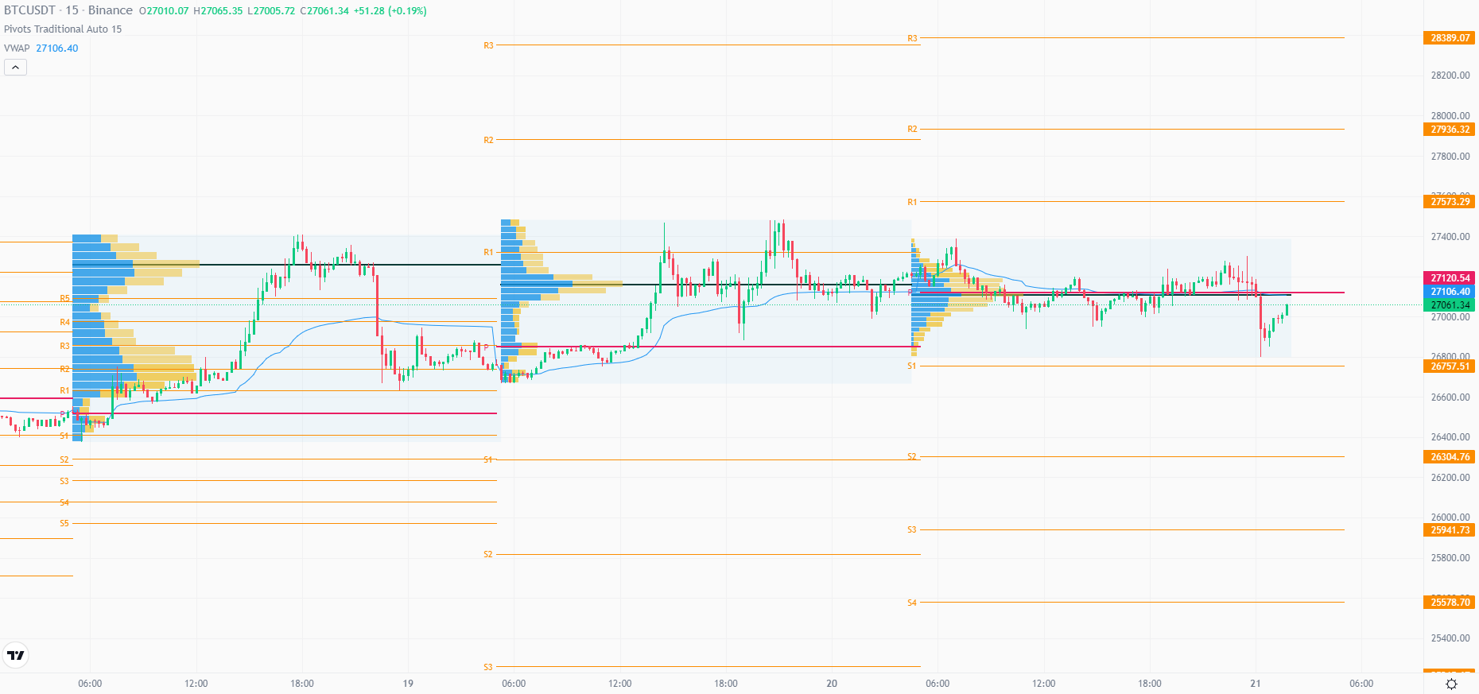
VPSV (HD)

Slide 22
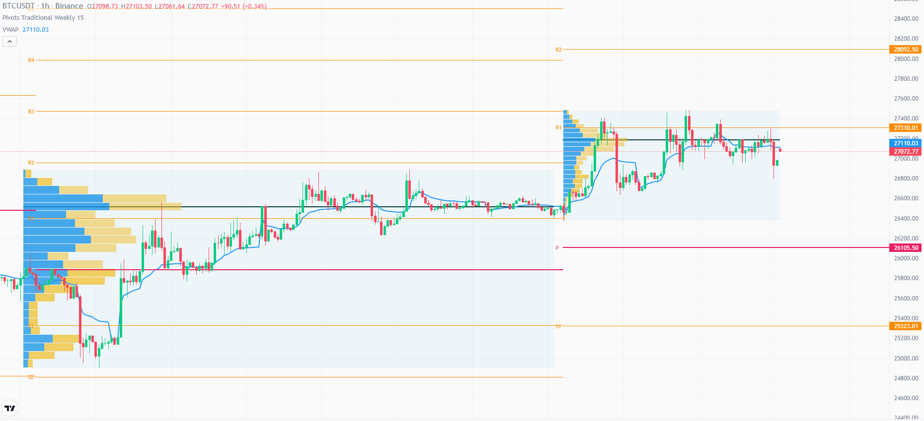
VPSV (HD)

